Slide 1

Leave Management Application
GROUP MEMBER NAMES:
20104041 - Saniya Dutta
20104001 - Shreya Mahajan
20104033 - Anish Bhosale
20104031 - Kunal Palande
Project Guide
Prof. Susmita Das
Notes:
1
1

Slide 2
Contents
Introduction
Objectives
Scope
Features / Functionality
Project Outcomes
Technology Stack
Block Diagram
Notes:
2
2

Slide 3
Introduction
1. The common problems faced by students these days is related
to keeping a track of their attendance with respect to the attendance
norms.
2. With the help of the proposed application, concerned faculties will have proper information about the leave statuses of the students. Thus making the Leave Management Application very useful for college in order to maintain the leave records of the students.
3. This application offers an easy to use interface.
4. It is a reliable application when compared to the traditional process of
managing leave records.
Notes:
3
3

Slide 4
Objectives
1. To automate the existing leave management process in educational
institutes.
2. To decrease the paperwork.
3. To create an application with efficient, reliable record maintenance by
using centralized database, thereby reducing chances of data loss.
4. To provide the users with a user-friendly interface.
Notes:
4
4

Slide 5
Scope
1. To build a user friendly leave management application.
2. To maintain the leaves of the student accurately.
3. To track and review the attendance of the students.
4. To build an administrative account which only the administrator is
guaranteed access.
Notes:
5
5

Slide 6
Feature/Functionality
Feature 1 : All-in-one Dashboard
Students can view their leave balance while applying for leave. Supervisors and HR staff have access to student leave balance, holiday lists and workforce coverage to evaluate the leave requests better.
Feature 2 : Auto Update Leave Balance
This application tracks the leave history of all students and displays it to both students and the faculty members
Feature 3: Unique ID generation
The admin can approve or deny requests from students using a unique id generated for each leave request.
Notes:
6
6

Slide 7
Outcome of Project
To provide efficiency in keeping track of attendance of students.
To provide the admin with the reasons for the leaves and reduce paper work.
To report the overall attendance of students.
Notes:
7
7

Slide 8


Technology Stack
1.FRONTEND: Frontend is made by using Visual Studio Code.
2. BACKEND: Backend is made by using SQLite.
Notes:
8
8

Slide 9
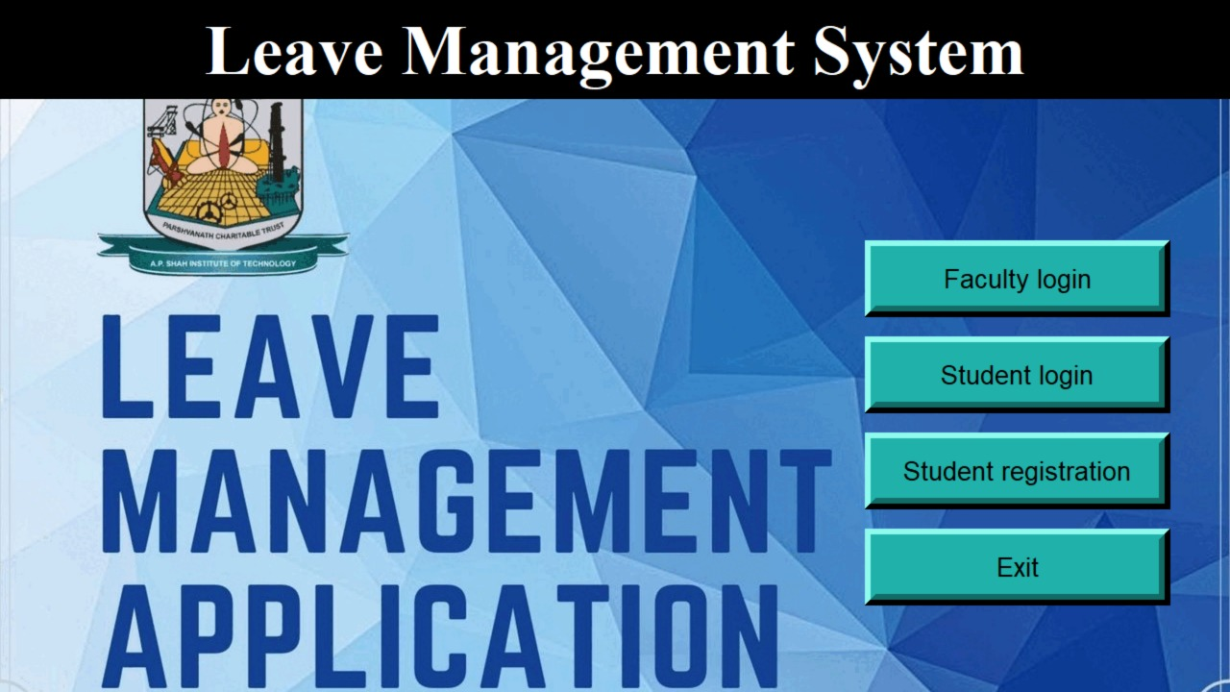
HOME PAGE

Slide 10
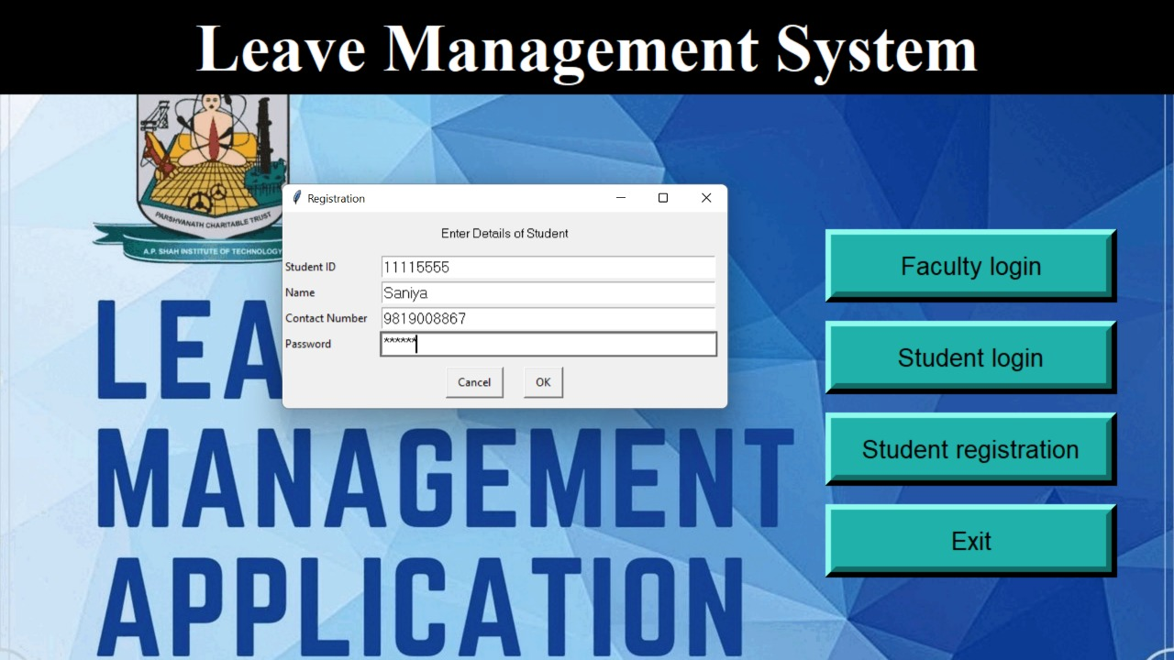
STUDENT REGISTRATION

Slide 11
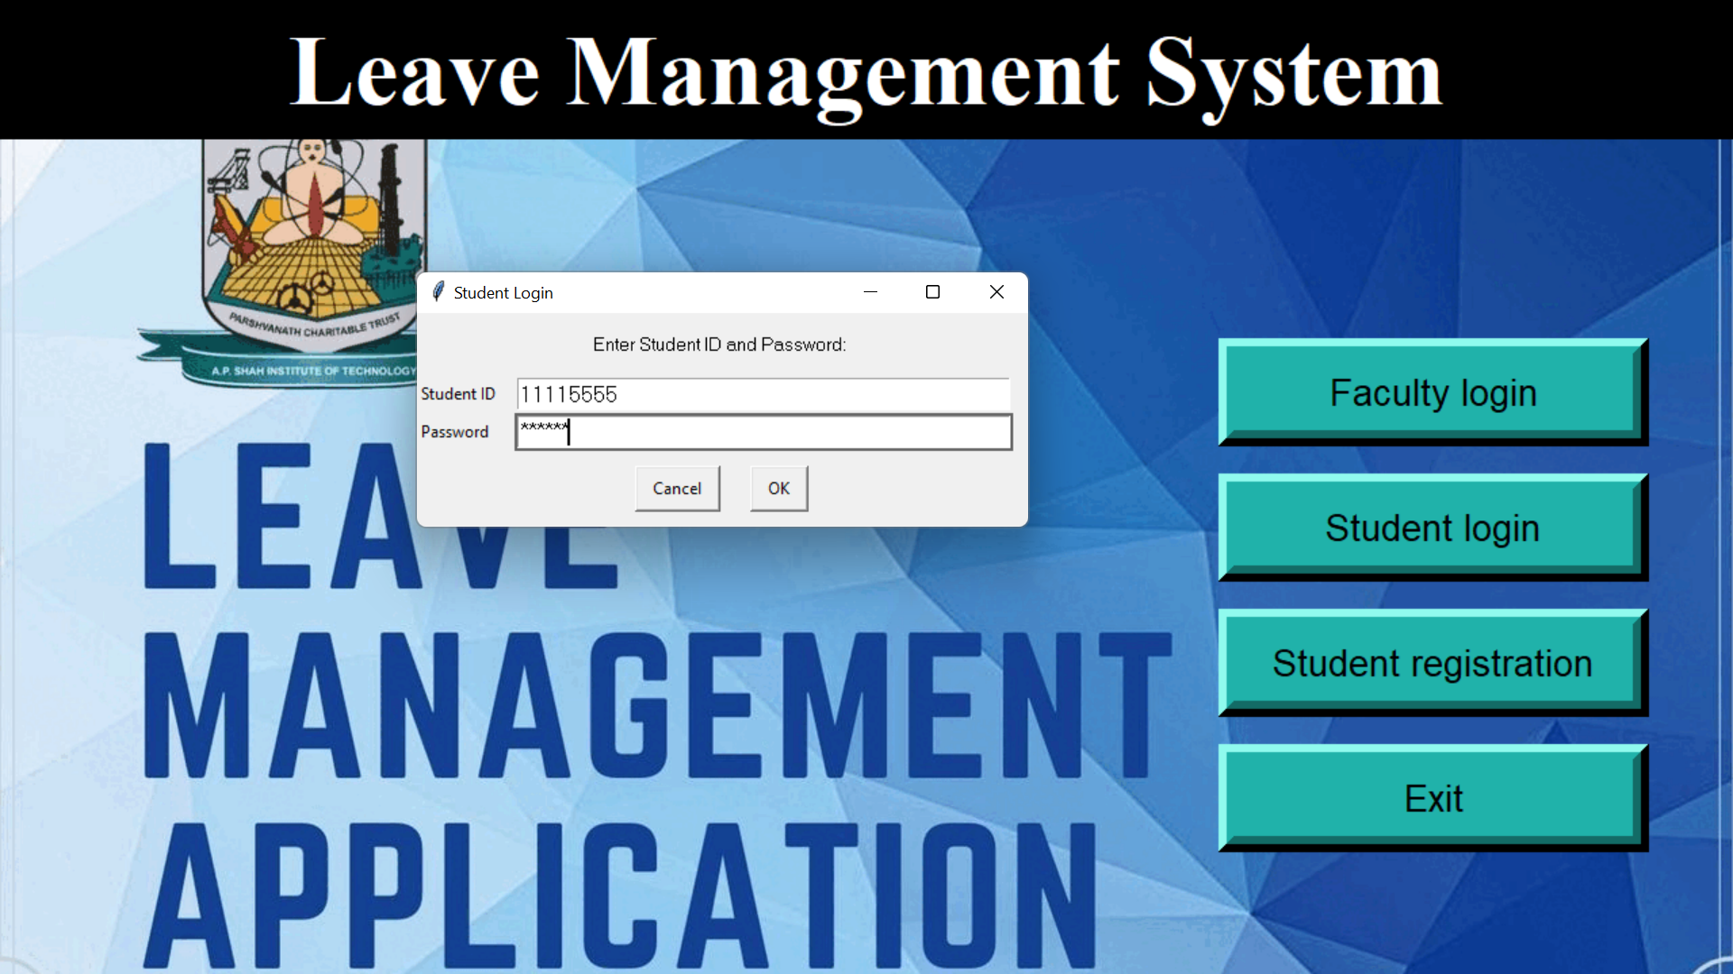
STUDENT LOGIN

Slide 12
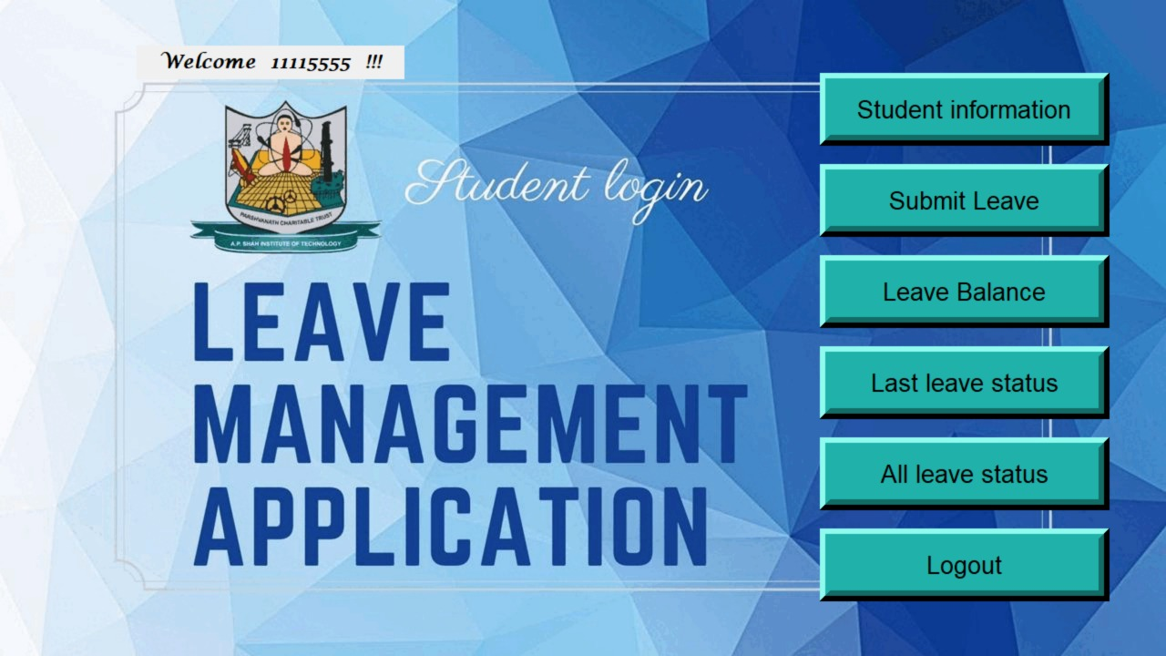
STUDENT LOGIN PAGE

Slide 13
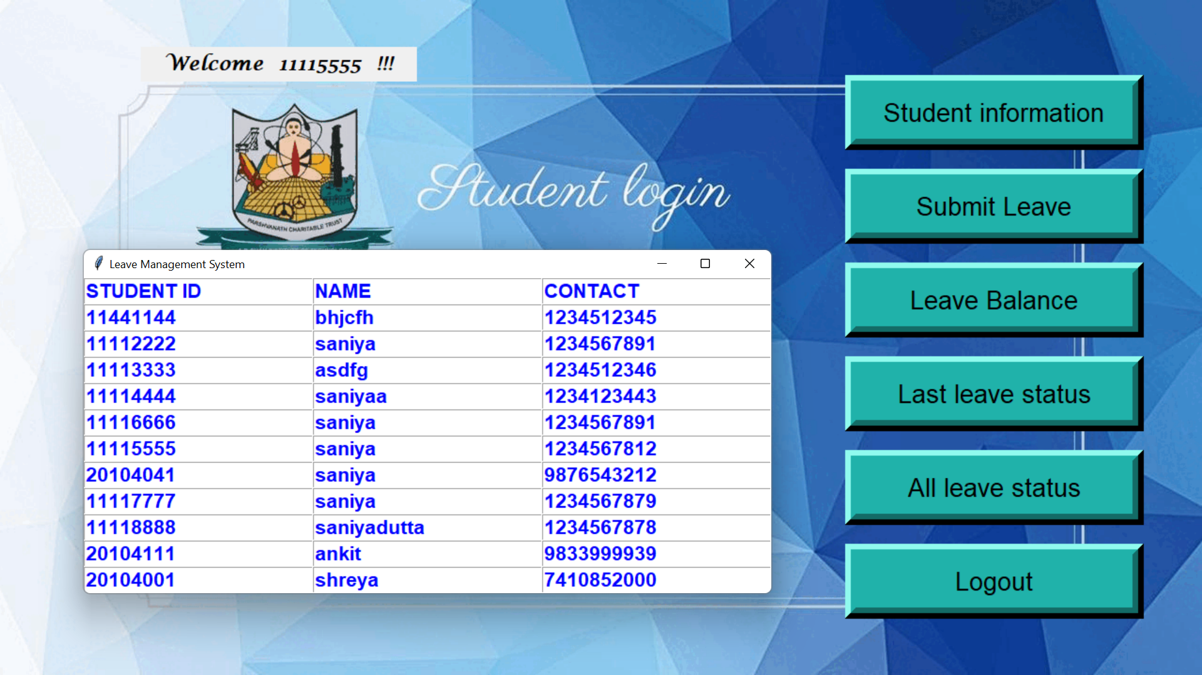
STUDENT: Student Information

Slide 14
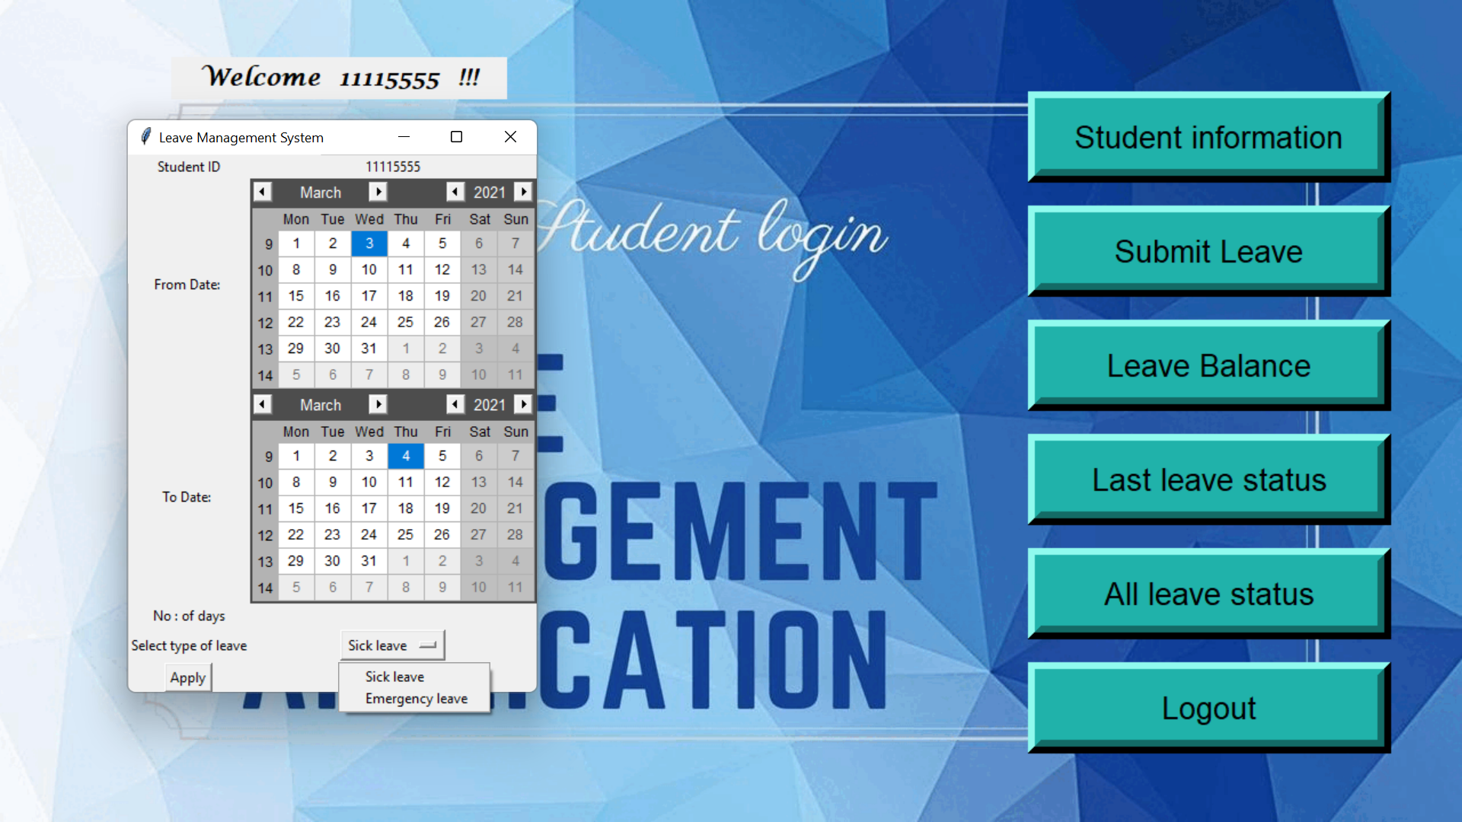
STUDENT: Submit Leave

Slide 15
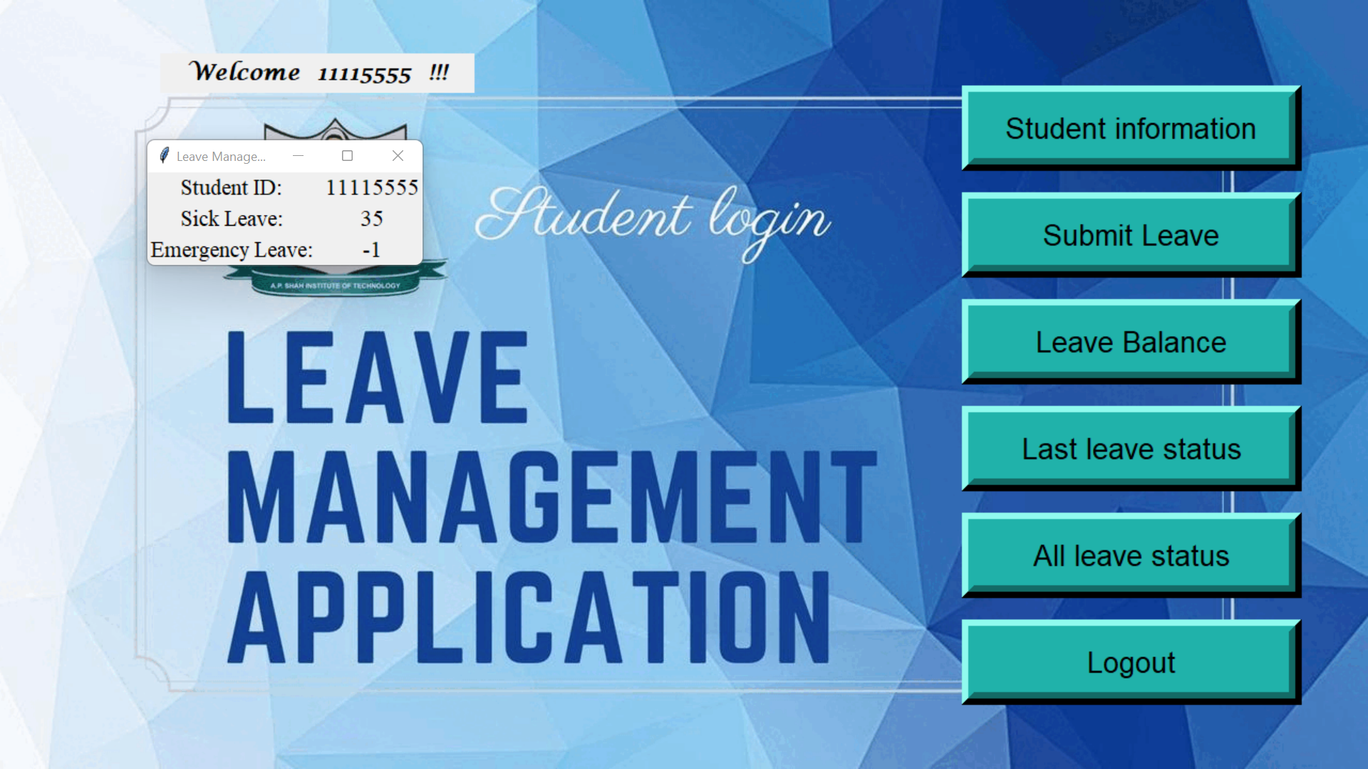
STUDENT: Leave Balance

Slide 16
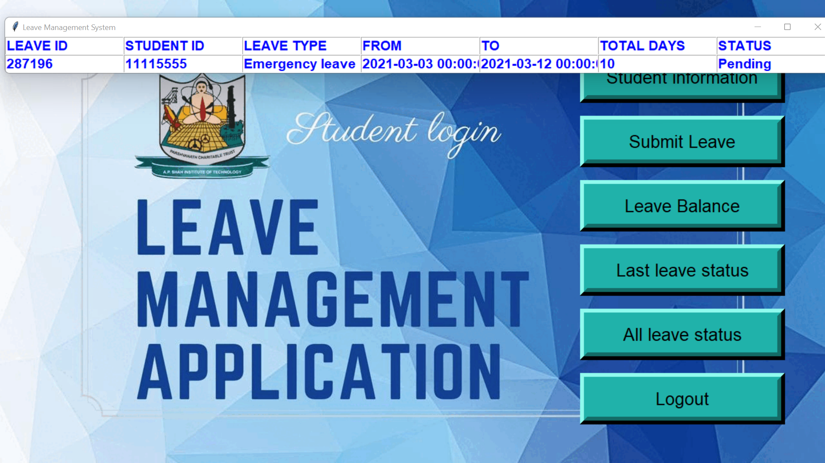
STUDENT: Last Leave Status

Slide 17
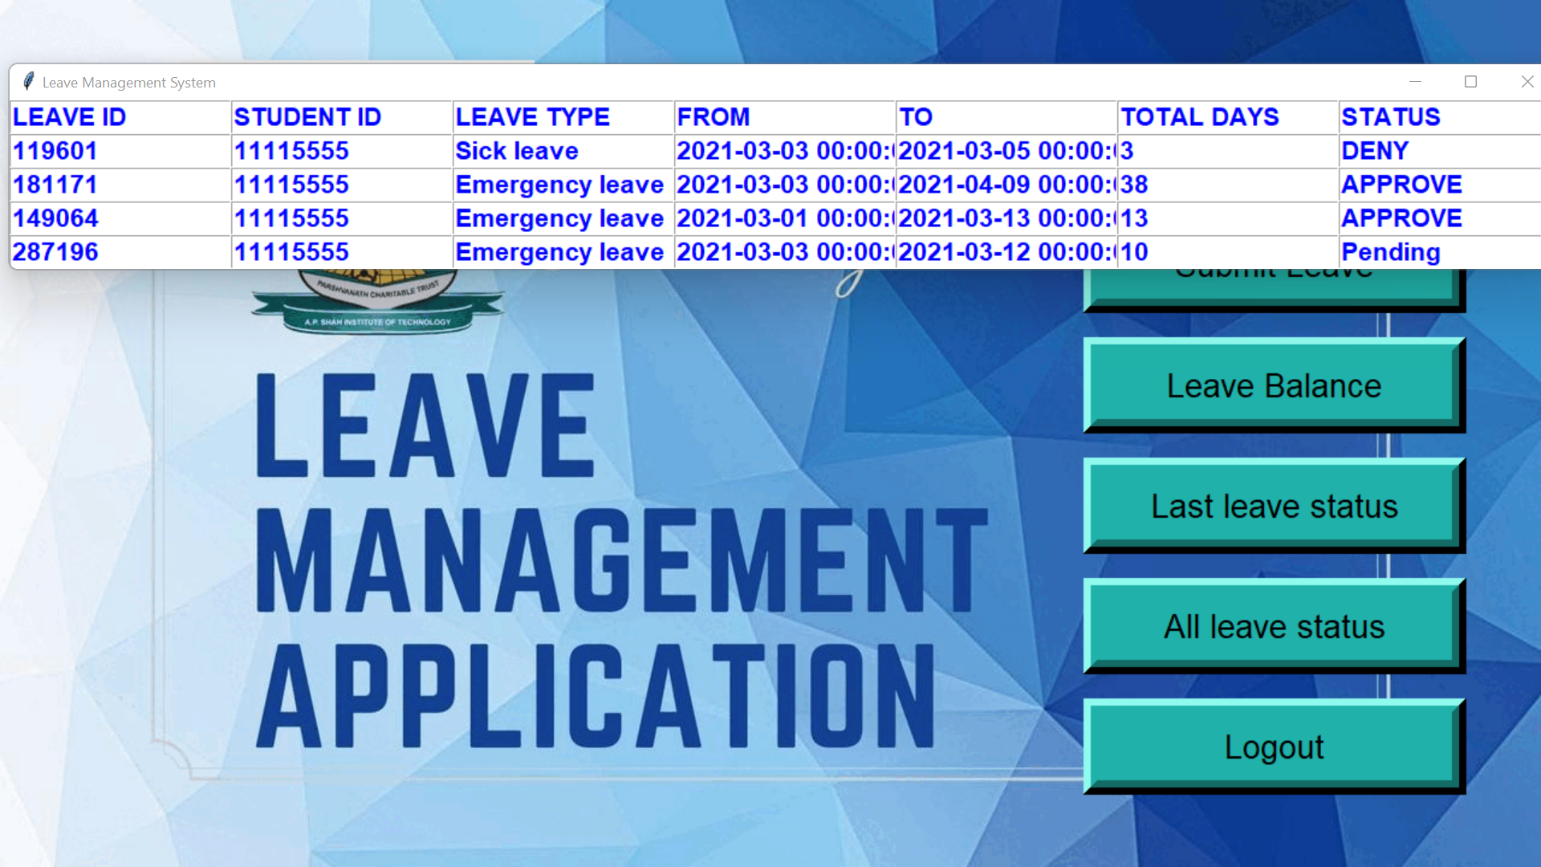
STUDENT: All Leave Status

Slide 18
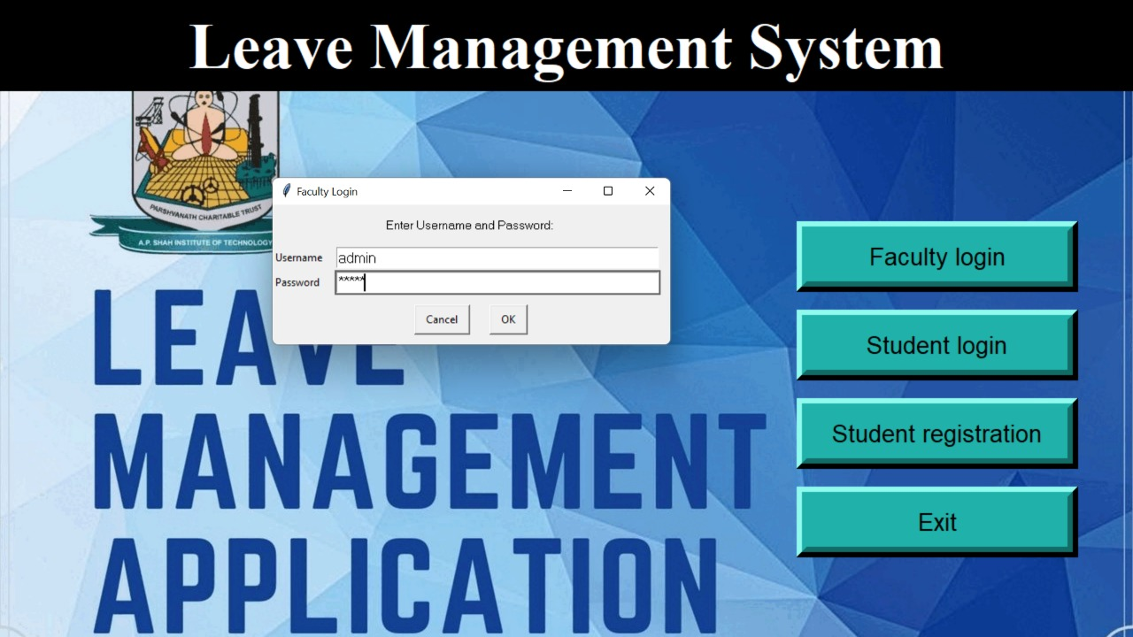
FACULTY LOGIN

Slide 19
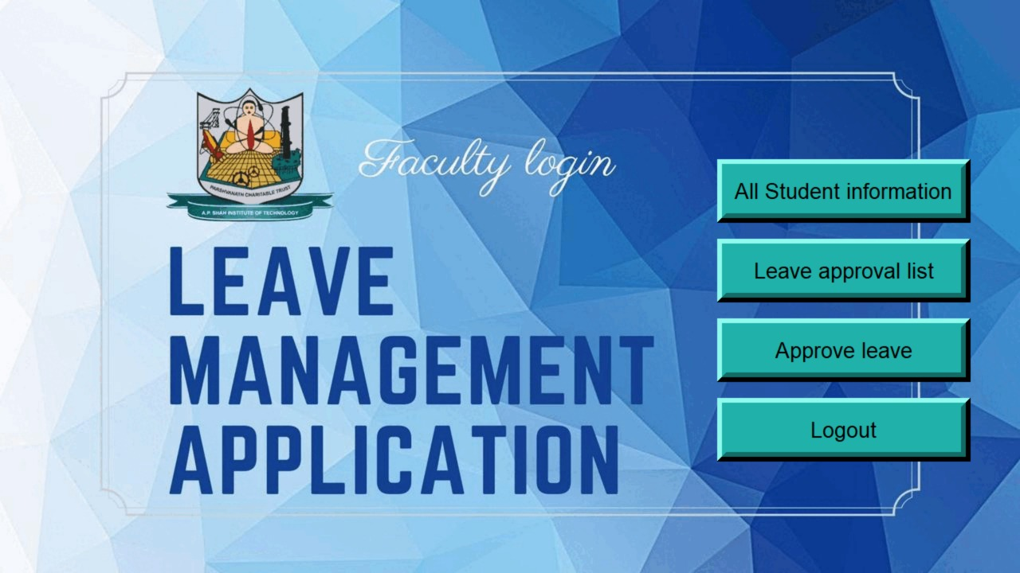
FACULTY LOGIN PAGE

Slide 20
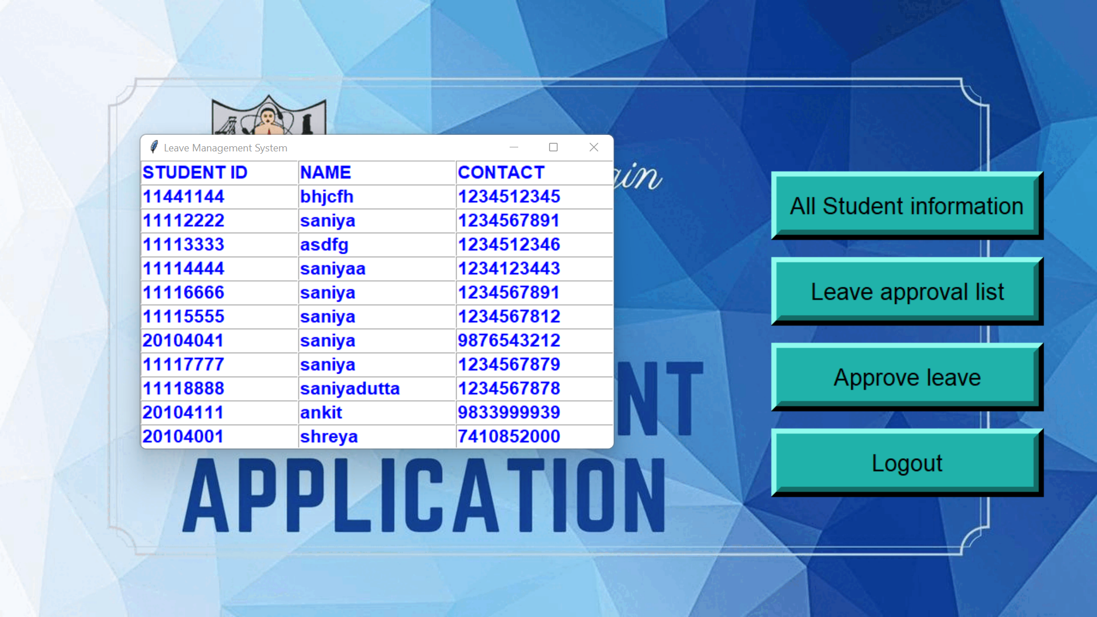
FACULTY : All Student Information

Slide 21
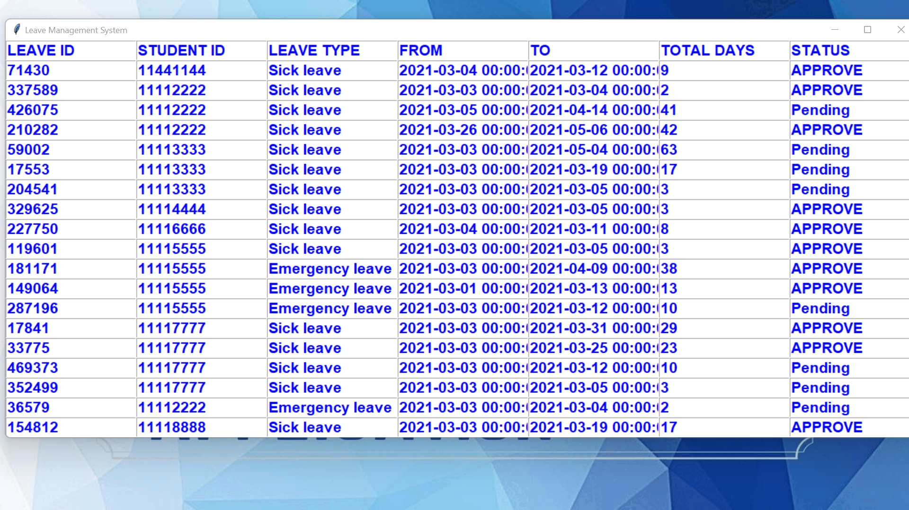
FACULTY : Leave approval list

Slide 22
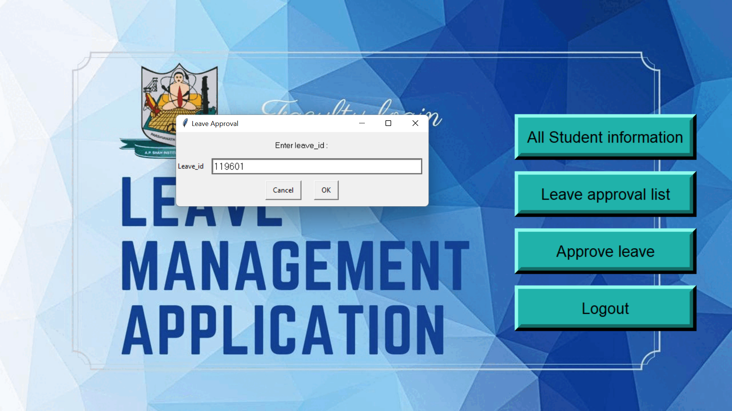
FACULTY: Approve Leave

Slide 23
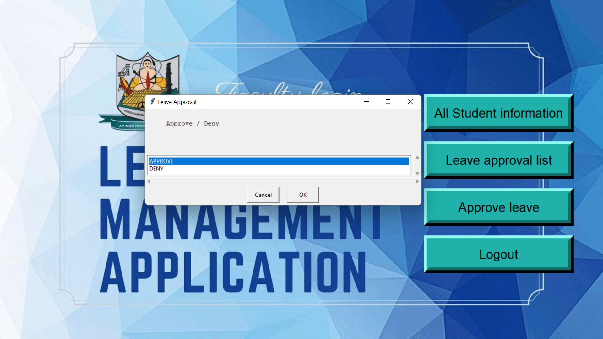
FACULTY: Approve Leave

Slide 24
Leave Management Application
Student login
Student Registration
Faculty login
After student login he/she can view student information, can submit leave, can check leave balance and also can check leave status
In student registration, a new student can register himself by putting his student id, name, contact number and password
After Faculty login, faculty can view all student information, can check approval list and can approve or decline a new request
Student can apply for leave by selecting no. of days
After student registration, student information gets stored in database
Faculty can approve or deny a new leave request

Slide 25
Thank You!!
Notes:
25
25

